Slide 1
AORTIC ARCH ANOMALIES
Dr.Santhosh Narayanan

Slide 2
Topic outline
Embryology
Anatomy
Classification
Individual anomalies

Slide 3
Embryology-Sequence of Events
Day I8 - Cardiac precursor cells seen in the form of blood islands
Day 20 - First intraembryonic blood vessels
Day 21- Folding, heart tube formation,looping
Day 22 – heart starts to beat
Day 28 – embryonic circulation established

Slide 5
The Cardiac Neural crest

Slide 6
Normal aortic arch development Rathke's model

Slide 8
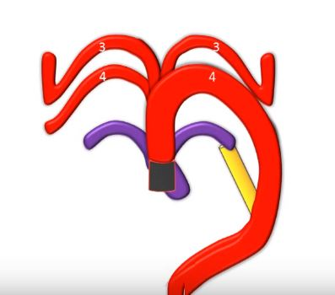
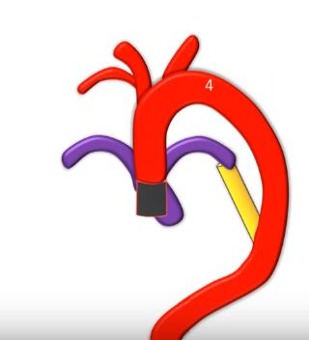
1st arch remnant-Maxillary Art.
2nd arch remnant-Stapedial Art.

Slide 10
Intersegmental Arteries
Intersegmental artery | Development
Cervical | All except 7th merge into vertebral artery
7th cervical intersegmental | Subclavian artery
Thoracic | Intercostal artery
Lumbar | All except 5th -becomes lumbar arteries
5th Lumbar | Common iliac artery
Sacral | Lateral sacral artery

Slide 11
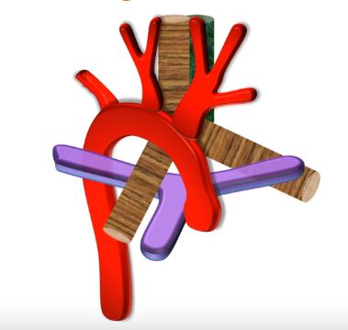
Arch sidedness

Slide 12
Edward's hypothetical double aortic arch model

Slide 13
Anatomy
Branches
Anastomoses

Slide 14
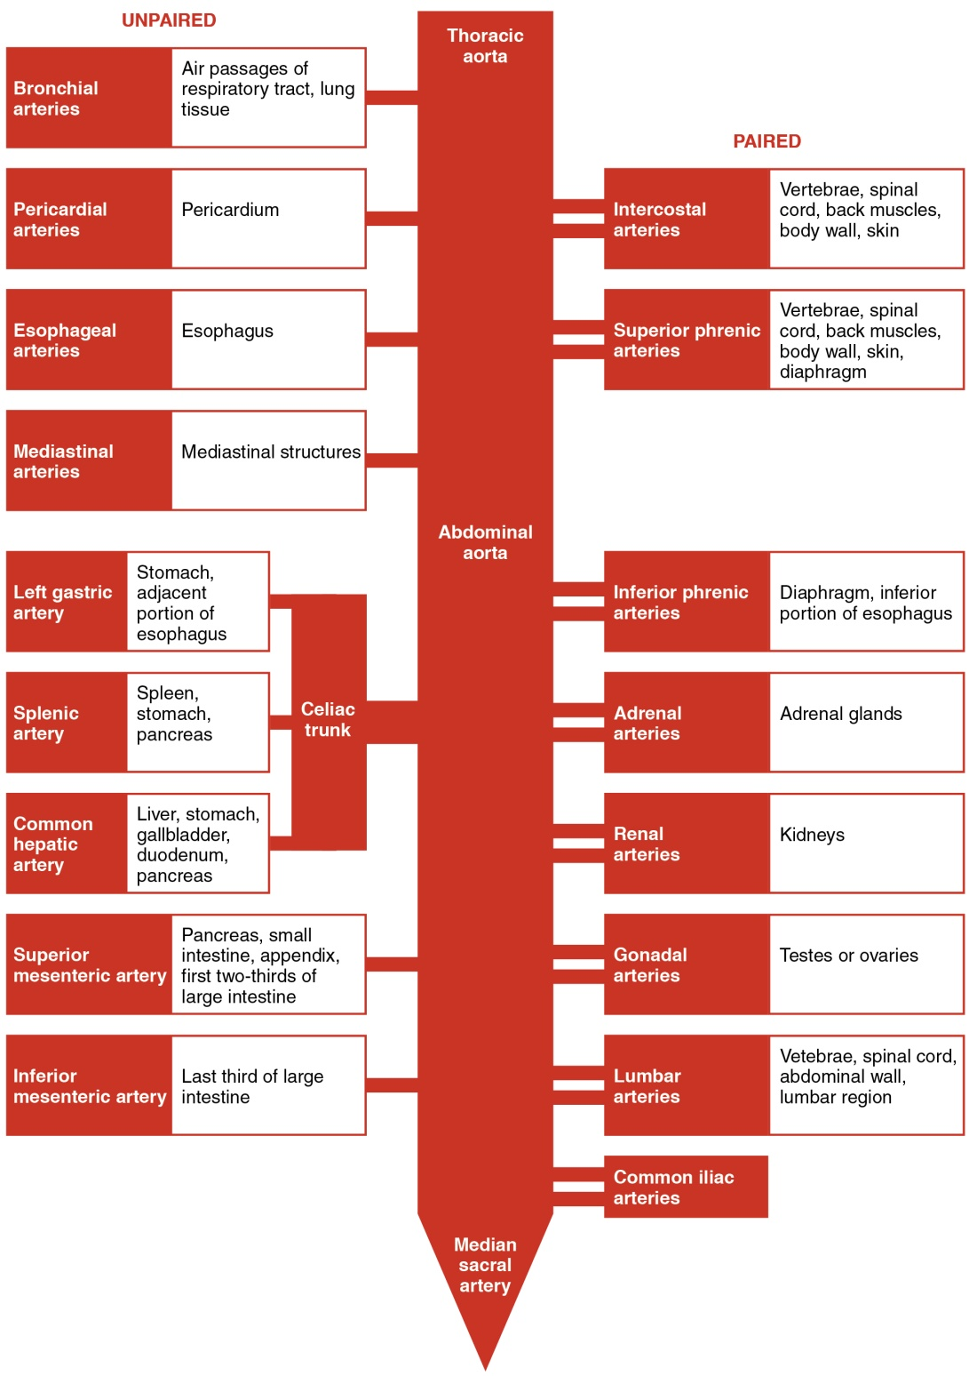

Slide 17
History
Hunault in 1735- pathologic description of anomalous right subclavian artery.
Double aortic arch-Hunault 1735
First report of clinical syndrome of vascular compression-Wolman 1939
Kommerel in 1936 –xray findings of anamolous right sca
First division of a vascular ring -Gross in 1945
First successful repair of interrupted aortic arch-Merrill et al. in 1957

Slide 18
Stewert's Anatomical Classification
1.Abnormal branching - of Lt Arch
2.Abnormal arch position -Rt Arch,Cervical Arch
3.Supernumary arches - DAA,Persistent 5th Arch
4.Interrupted aortic arch -
5.Anomalous origin of PA branches

Slide 19
Freedom's clinical classification
Vascular rings
Non ring vascular compression of the trachea, bronchi, or esophagus
Noncompressive arch malformations
Ductal-dependent arch anomalies including interrupted aortic arches
Isolated subclavian, carotid, or innominate arteries
Genetic syndromes and associated abnormalities.

Slide 20
Clinical Presentations
Aortic Arch Configuration | Clinical Presentation
1.LEFT AORTIC ARCH
A. Branching variants | Asymptomatic
B. Aberrant Rt Subclavian | Tracheoesophageal compression(Rare)
C. Isolation of Rt Subclavian | Subclavian steal
2.RIGHT AORTIC ARCH
A. Mirror image | Symptomatic with other associated CHD
B. Aberrant Rt Subclavian | Tracheoesophageal compression(Rare)
C. Isolation of Rt Subclavian | Subclavian steal
3.DOUBLE AORTIC ARCH | Tracheoesophageal compression
4.CERVICAL AORTIC ARCH | Neck mass,pressure symptoms

Slide 21
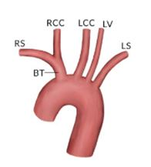
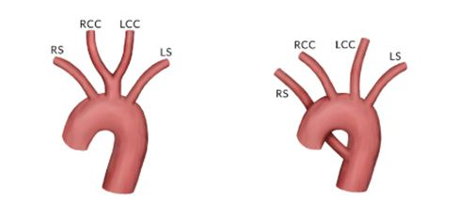
Branching variants

Slide 22
Separate origin of vertebral artery

Slide 23
Bovine arch variant in humans

Slide 24
True bovine arch -Uncommon

Slide 25
Left aortic arch with aberrant right subclavian(ARSA)

Slide 26
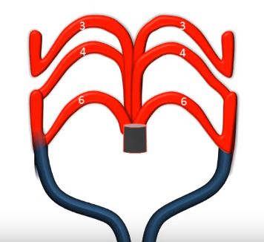
Embryology

Slide 27
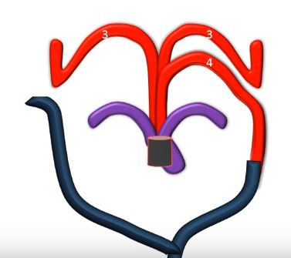
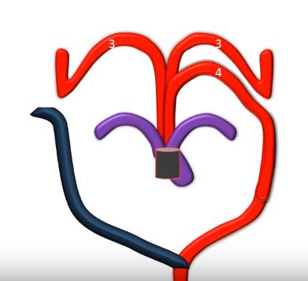

Slide 28
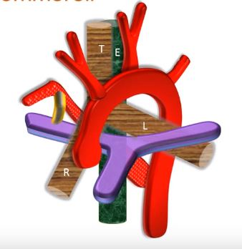
Left arch with diverticulum

Slide 30
Edward's model

Slide 31
Left arch with isolation of right subclavian artery

Slide 32
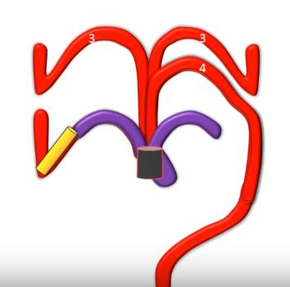

Slide 33
Left arch with isolation of right subclavian artery
Rare
SCA arises from ductus arteriosus
If PDA closes,retrograde flow from vertebral artery via circle of willis
Subclavian steal
Treatment - Re implantation of SCA to aorta

Slide 34
Right Aortic Arch
Associated with CHD -mainly conotruncal anomalies
TOF -13-34%
Truncus arteriosus -50% max incidence
TGA
VSD PS,Pulm.atresia,DORV
4 Major patterns
1.Mirror image branching
2.Retroesophageal LSCA
3.Retroesophageal Diverticulum
4.Circumflex aorta with rt arch

Slide 35
Rt aortic arch is rare with
CCTGA
LVOT Obstruction-cong AS
HLHS

Slide 36
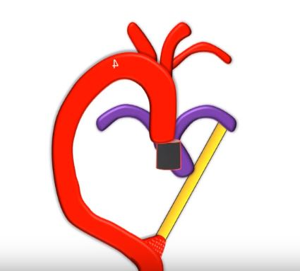
Rt Arch with mirror image branching

Slide 38
Rt arch with retroesophageal LSCA

Slide 39
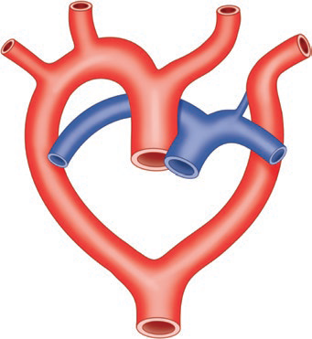
Rt arch with retroesophageal LSCA

Slide 40
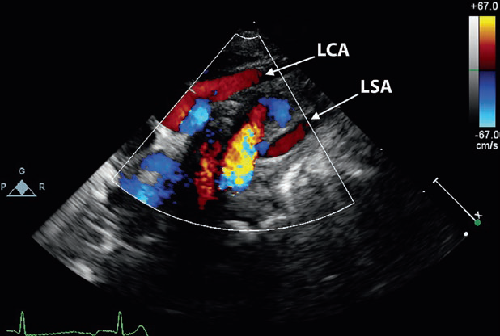

Slide 41
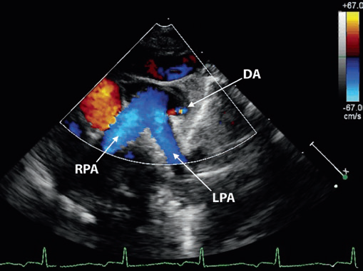

Slide 42
Rt Arch with diverticulum

Slide 43
Circumflex aorta with Lt Arch

Slide 44
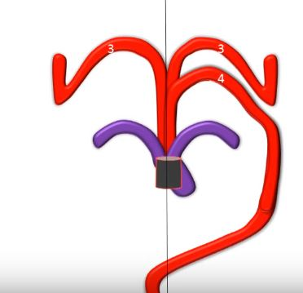
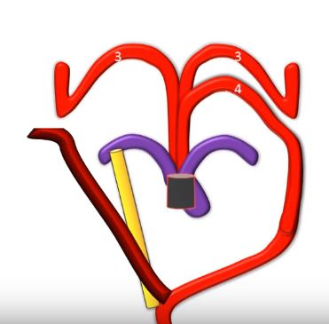
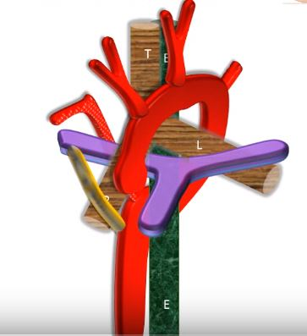

Slide 47
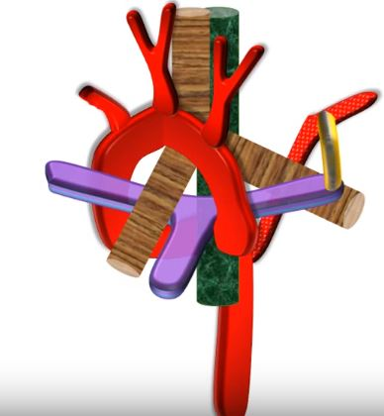
Circumflex aorta with Rt arch

Slide 49
Double aortic arch
Both R and L arches persist
Most common of the vascular rings(55%)
Types
(1) Balanced - both arches dominant(equal size)
(2) Right Arch dominant and Left partially atretic
(3) Left Arch dominant and right partially atretic
Not usually a/w other cong.heart defects
Trisomy 21,18,TOF,VSD -Only in 10 %

Slide 52
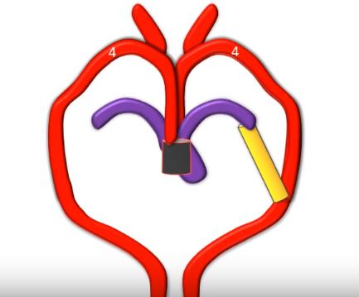
Embryology

Slide 53
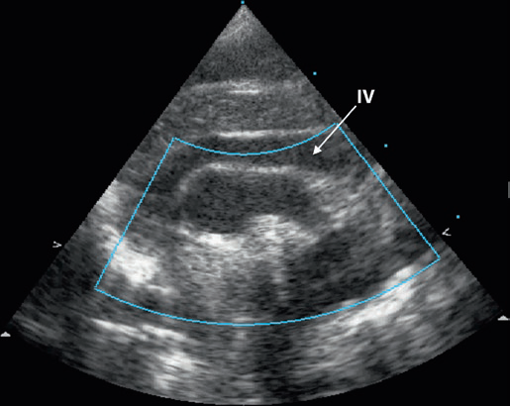
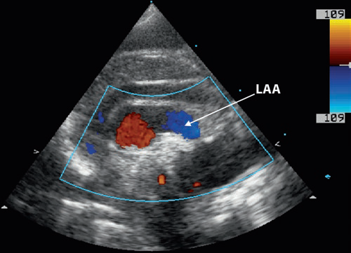

Slide 54
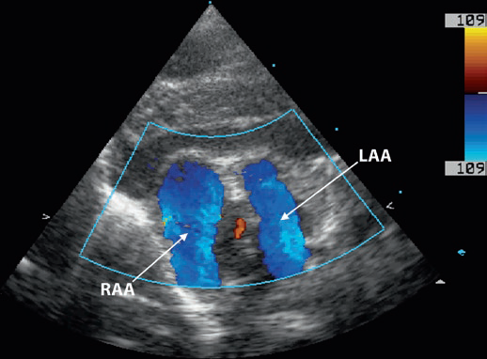

Slide 55
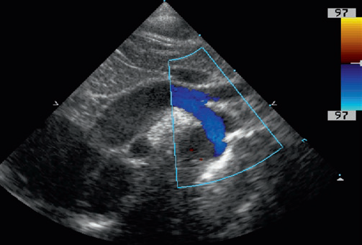
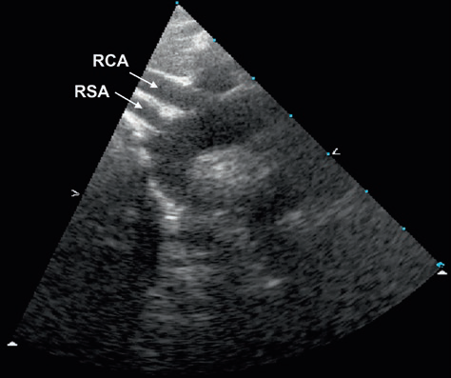
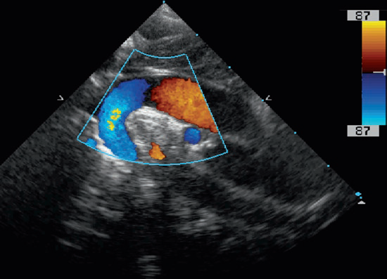

Slide 56
Double aortic arch with Type A of IAA

Slide 57
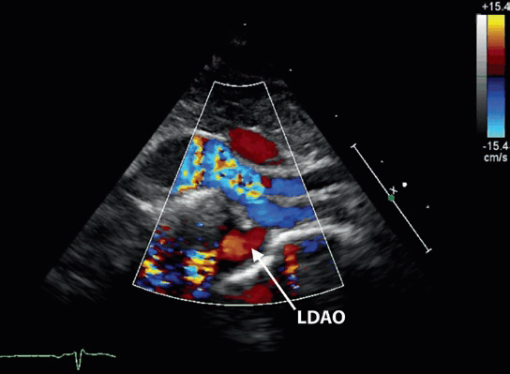
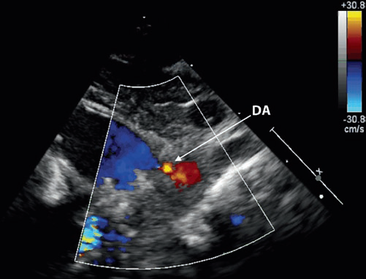

Slide 58
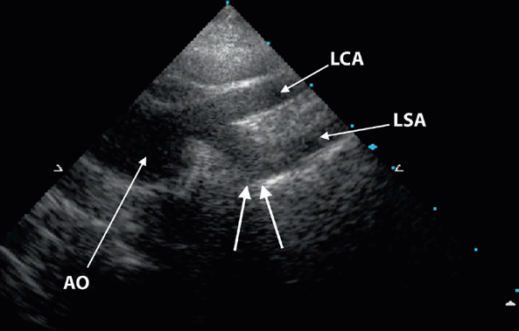
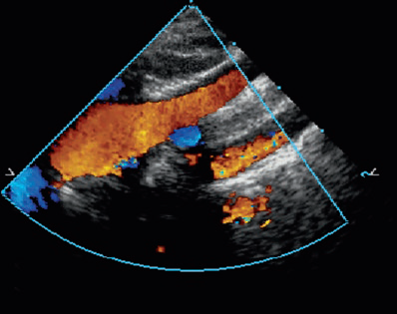

Slide 59
DAA with Type A IAA
Similar to RT arch with mirror image branch and left DTA
Indistinguishable by imaging

Slide 60
DAA with Type B IAA

Slide 61
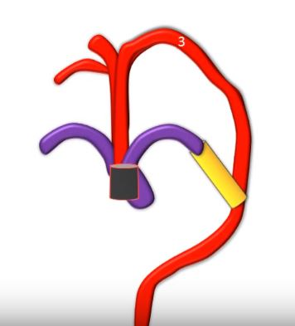
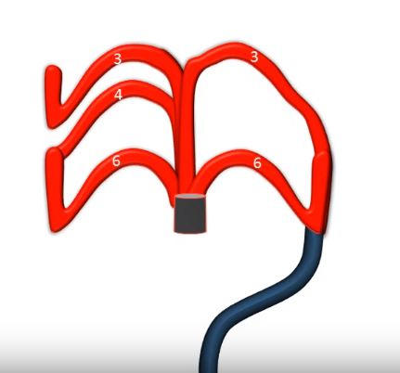
Cervical aortic arch

Slide 64
Cervical arch-different types

Slide 65
Cervical aortic arch

Slide 66
Persistent 5th Arch

Slide 67
Persistent fifth arch

Slide 68
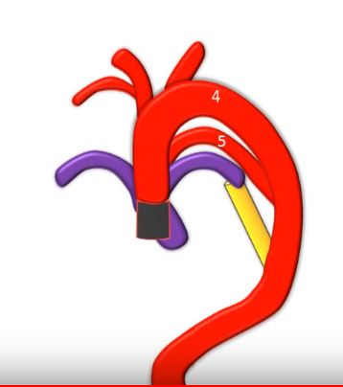
Embryology

Slide 70
Persistent fifth arch with IAA

Slide 71
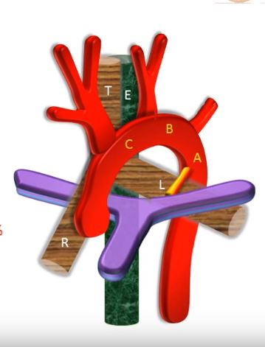
Interrupted aortic arch

Slide 72
Celoria and patten classification

Slide 73
3 Subcategories in each
Without retroesophageal or isolated SCA
With retroesophageal SCA
With isolated SCA

Slide 74
Type A (30-44%)
Aorticopulmonary septal defect and intact ventricular septum,TGA with IVS
Type B (51-70%)
More common
a/w conotruncal anomaly with normally aligned great arteries
Large malalignment-type VSD
Posterior displacement of the infundibular septum and subaortic obstruction
Type C
Very rare

Slide 75
Type B and Digeorge syndrome
43% were found to have type B interruption
68% of interrupted arch patients had DiGeorge syndrome
Truncus arteriosus - comparable figures were 34% and 33%, respectively

Slide 76
Presentation
Duct dependent obstructive lesion
CHF after PDA closure
Pulse discrepancy depends on branching pattern
Absence of all limb pulses in type B
Differential cyanosis rare if Large VSD+

Slide 78
Treatment
PGE1
Surgical
-Staged repair
-Single stage repair
LVOT Obstruction
Aberrant RSCA

Slide 79
Other anomalies of aortic arch system
1.Anomalous origin of pulmonary artery from ascending aorta
2.Anomalous origin of LPA from RPA
3.Innominate artery compression of trachea

Slide 80
PA from Asc.Aorta
MPA arises from heart
RPA or LPA arises from ascending aorta
RPA-more common -82%

Slide 81
Anomalous RPA
-abnormal migration
-aortopulmonary septation anomalies,IAA
Anomalous LPA
- Failure to join TA sac
-RAA and TOF
Differential pulmonary blood flow
CCF in infancy f/b development of PVR

Slide 82
Pulmonary artery sling

Slide 83
LPA arises as a branch of RPA
LPA courses in a position cephalad to right mainstem bronchus;between trachea & esophagus
Forms a "sling" and partially surrounds lower trachea
a/w tracheal stenosis
ONLY condition where a major vessel passes b/w trachea & esophagus

Slide 84
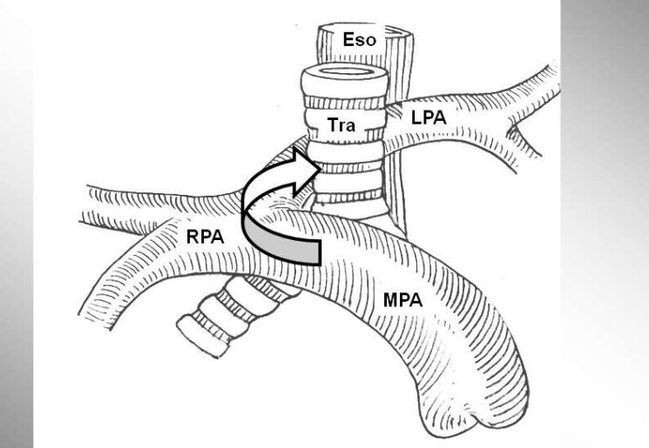
Severe respiratory distress and stridor
Symptomatic patients should be evaluated by bronchoscopy at the time of surgical repair - frequent association of complete cartilaginous rings
Surgical approach - division of the left pulmonary artery from the right and reanastomosis in front of the trachea

Slide 87
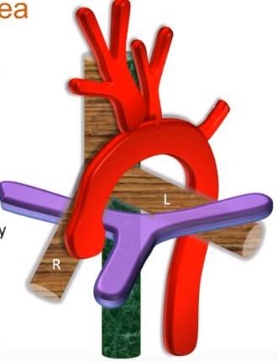
Innominate artery compressing trachea

Slide 88
MCQ 1
Which of the arches present as pulsatile neck mass
1.double aortic arch
2.Persistent 5th arch
3.Circumflex rt arch
4.Cervical arch

Slide 89
MCQ 2
Commonest type of IAA is

Slide 90
MCQ 3
All of the following can be associated with right aortic arch except
1.TOF
2.TGA
3.HLHS
4.DORV

Slide 91
MCQ 4
Which of the following is true
1.In circumflex rt arch -arch is on right and DTA is on left
2.Persistent fifth arch is characterised by two lumens on opposite side
3.In DAA with IAA,Right arch is more commonly atretic
4.Right arch with mirror image branch is not always associated with Congenital heart disease

Slide 92
THANK YOU

